Slide 1

Microservices
.NET

Slide 2
MicroServices Architecture (MSA) is an approach to developing an application as a suite of small ‘services’. Each service runs independently and communicates through HTTP with other services APIs. All these API’s combine to form a complete application.
https://martinfowler.com/microservices/

Slide 3
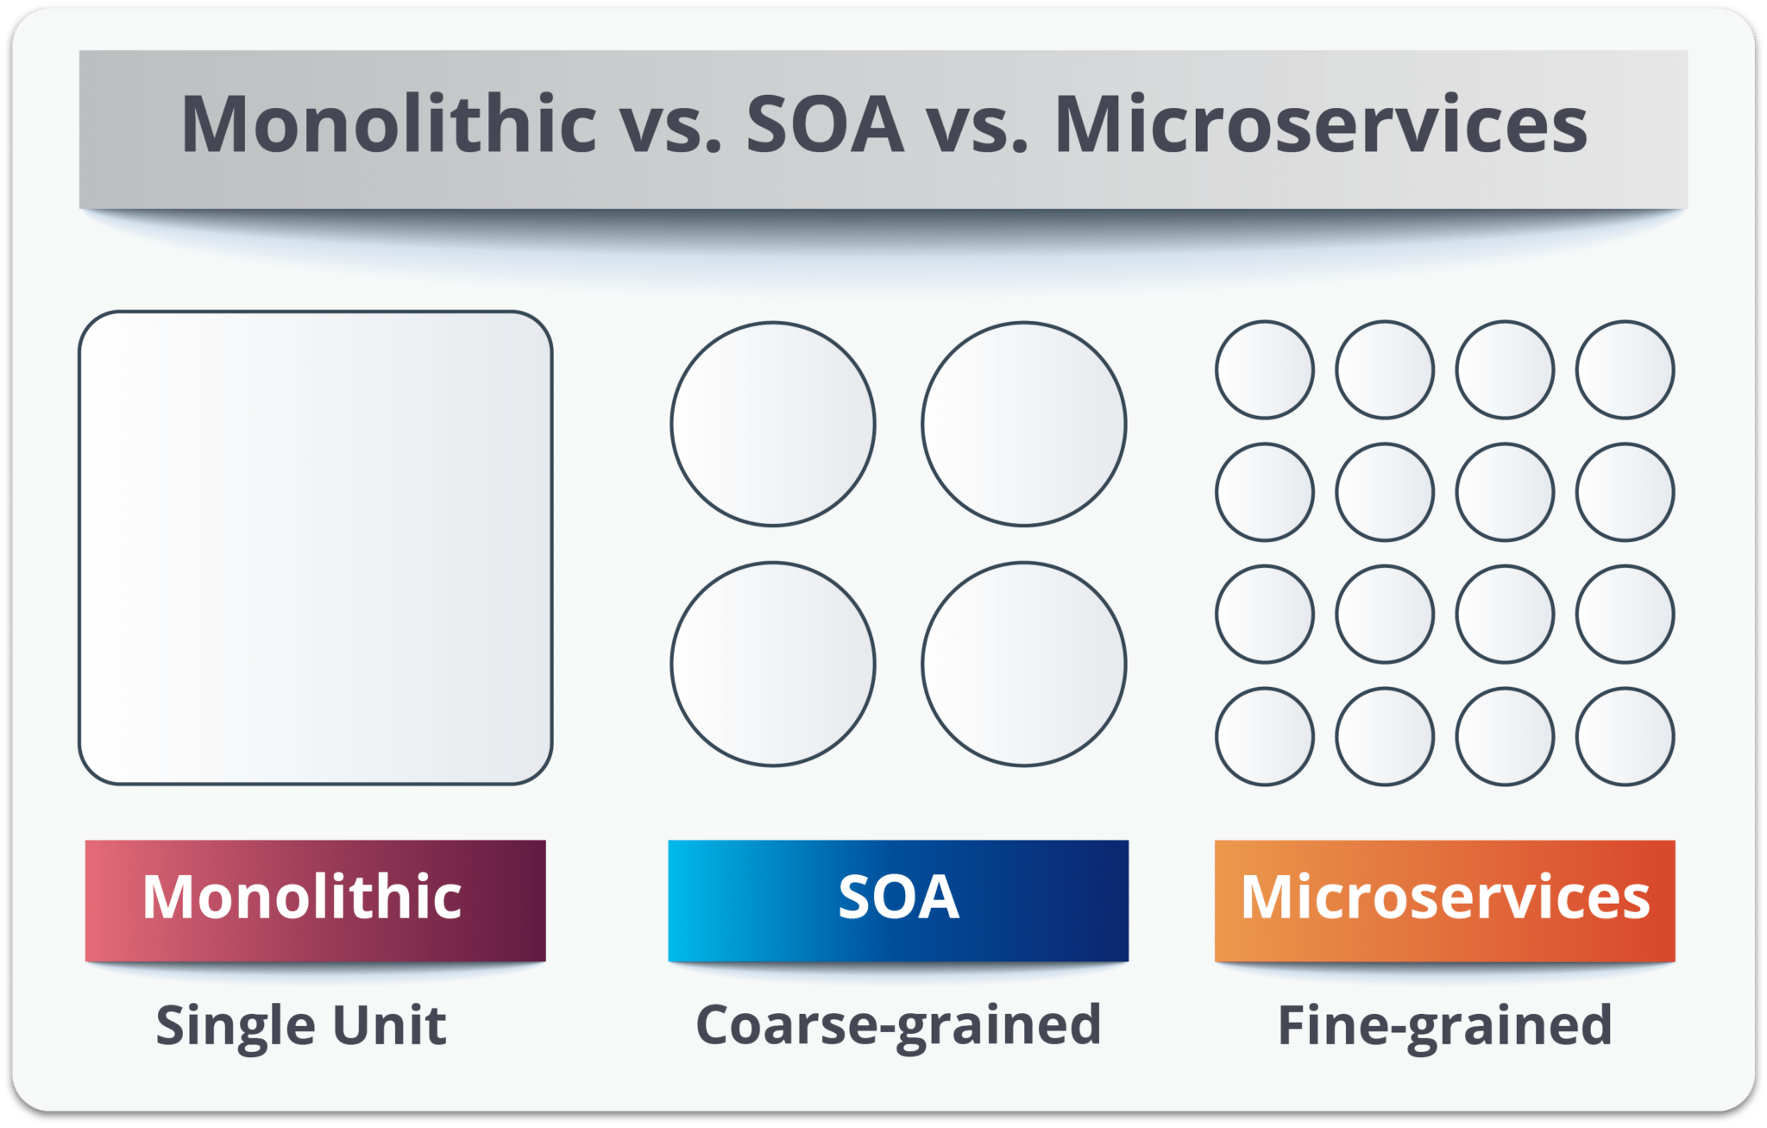
MSA vs. SOA https://dzone.com/articles/microservices-vs-soa-whats-the-difference https://www.bmc.com/blogs/microservices-vs-soa-whats-difference/ https://www.guru99.com/microservices-tutorial.html
Service Oriented Architecture | Microservices Architecture
Divisions based on business functionality | Divisions based on ‘bounded context’
Often leverages a Service Bus for communication. | Uses a simple messaging system. (HTTP)
Support for multiple messaging protocols. | Uses lightweight protocols. (HTTP/REST)
Multi-threaded | Single-threaded
Focus on app reusability. | Focus on decoupling components.
Systemic change means altering the monolith or service. | Systemic change means adding a new instance of a service
CI/CD is becoming more popular | CI/CD is integral to development.

Slide 4
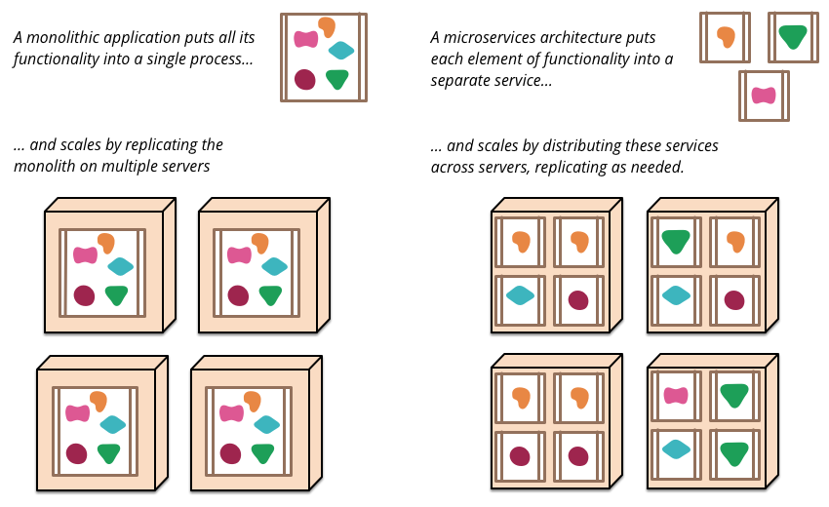
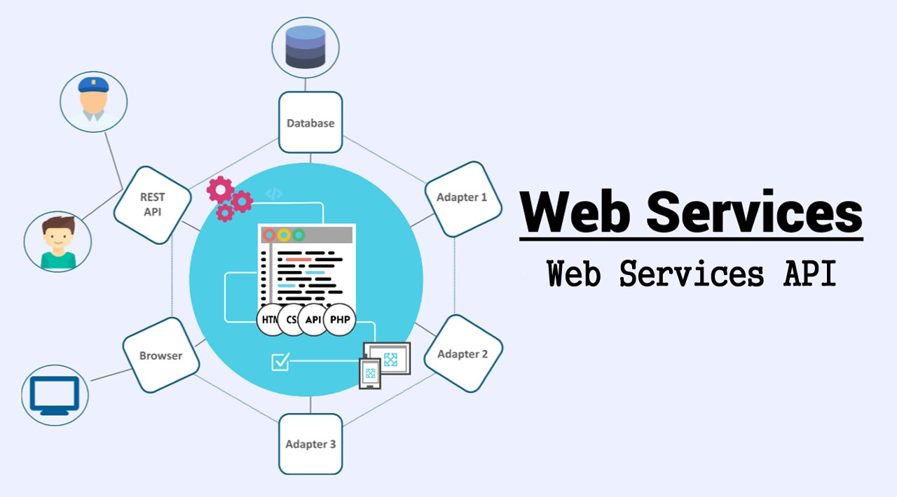
Web Services Review https://martinfowler.com/articles/microservices.html
In a “monolith” application, all the code (except DB and UI) is compiled together and deployed together. This approach presents certain problems.
One small change forces you to rebuild and redeploy the whole application as a new version.
It’s hard to keep the code well organized with its logical sections decoupled.
If one part of the app is a bottleneck the whole app is affected.

Slide 5
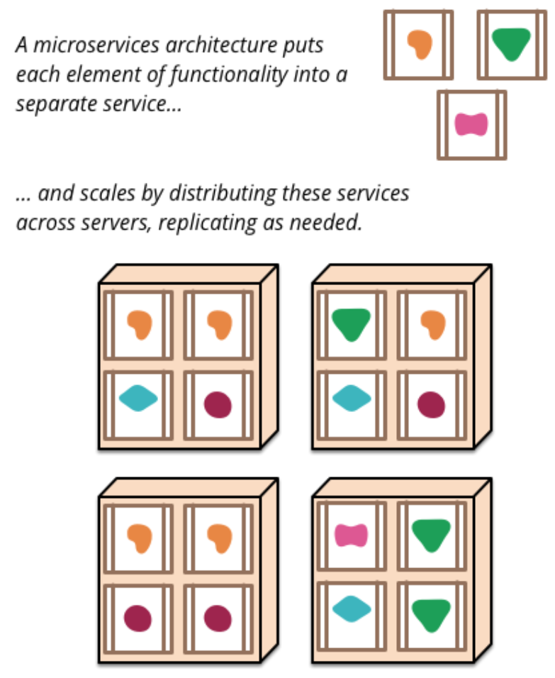
Microservices Architecture – Overview https://martinfowler.com/articles/microservices.html
The Microservice Architectural Style (MSA) can be seen as a subset of SOA. MSA means developing a suite of small, highly-focused services. Then integrating the services to create a single application.
MSA’s are built around business needs. Each service is independently deployable by a fully automated CI/CD pipeline.
Individual services are loosely coupled with no central
management. They may even be written in different programming languages with different data storage technologies.

Slide 6
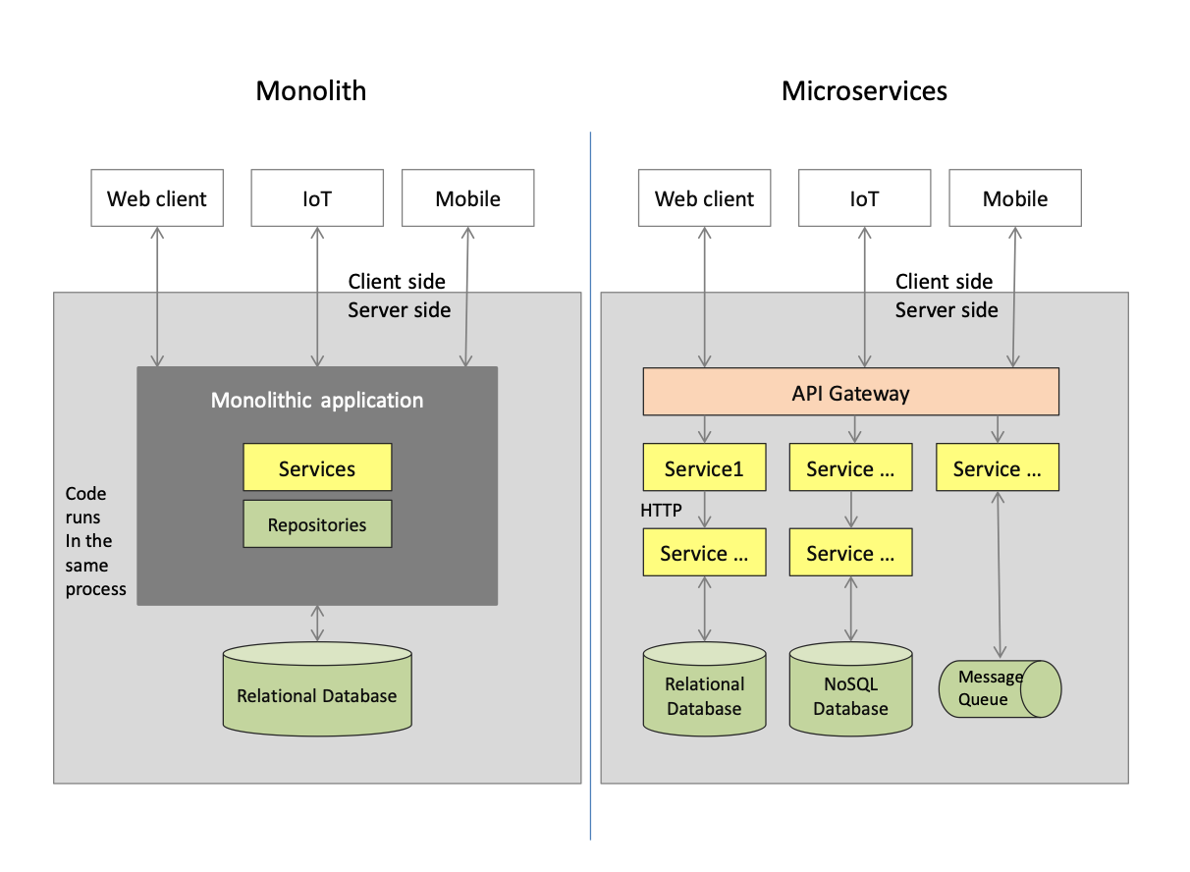
Microservices Architecture (MSA) – Overview https://martinfowler.com/articles/microservices.html
The basic characteristics of MSA are:
Application has SOA.
Avoids Conway’s Law.
“Products, not projects”
Developers are responsible for their service for its entire lifetime.
“Smart endpoints and dumb pipes”
Use HTTP to receive requests and respond, staying as decoupled as possible.
Use a lightweight message bus that acts as a message router only and doesn’t do much more than provide a reliable asynchronous fabric.
CI/CD

Slide 7
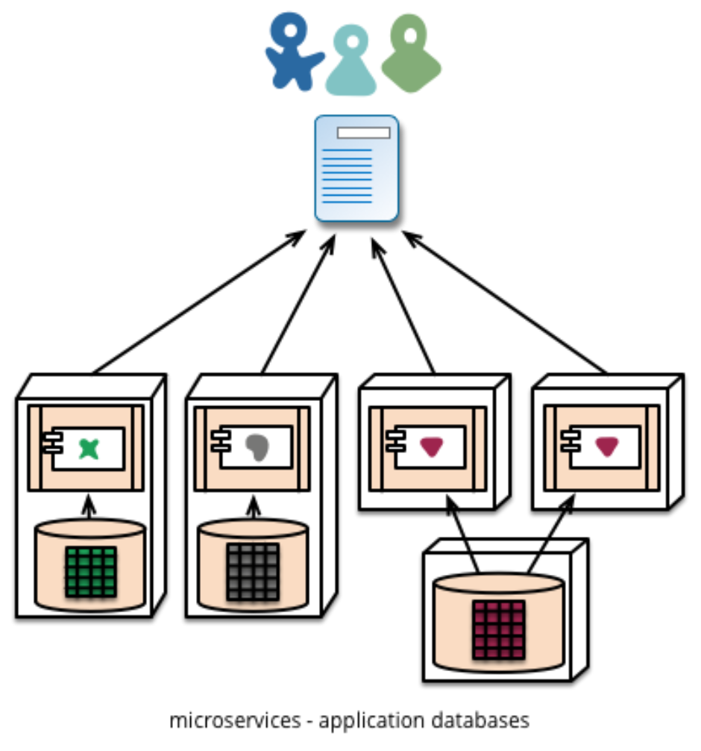
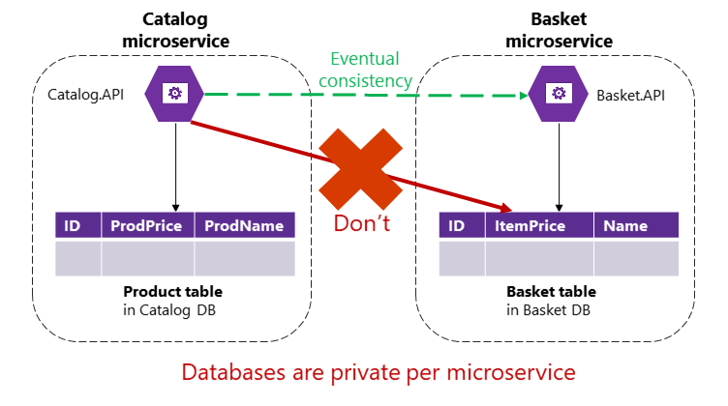
MSA Components – Overview https://martinfowler.com/articles/microservices.html
The basic characteristics of Microservices Components (services) are:
Each service implements a business capability.
Services are developed, deployed, and scaled independently.
Services control their own logic.
Services manage and persist their own data.
Each service is replaceable and upgradable.
Services communicate using RPC’s.

Slide 8
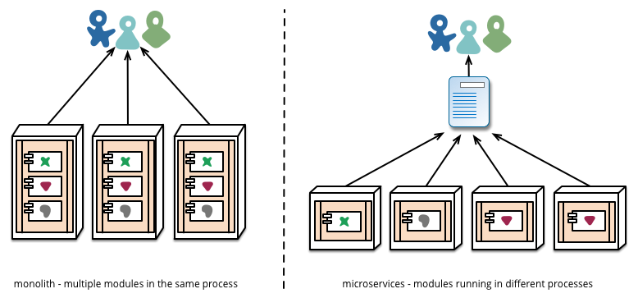
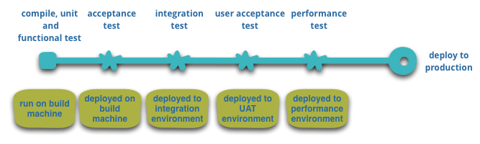
MSA and CI/CD https://martinfowler.com/articles/microservices.html
As long as deployment is “boring” there isn’t really a functional difference between monoliths and microservices.
The evolution of “the cloud” has reduced the operational complexity of building, deploying, and operating microservices.
Teams using CI/CD now make extensive use of infrastructure automation techniques.

Slide 9
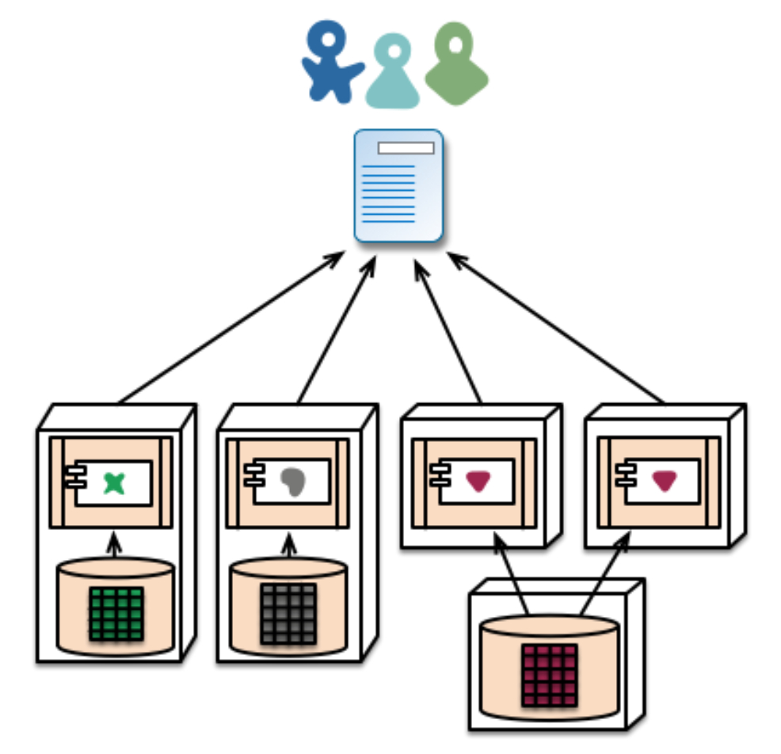
Pros of MSA https://developer.ibm.com/technologies/microservices/articles/challenges-and-benefits-of-the-microservice-architectural-style-part-1/
Long-term flexibility allows the addition of newly developed technologies.
Higher Return on Investment (ROI) and lower Total Cost of Ownership (TCO) with faster, less expensive hardware.
Fault isolation and bug fixing is made easier. This leads to higher resiliency.
Loose coupling is enforced by the architecture.
Smaller, easier-to-understand services help to quickly deploy new features.
MSA is easily scalable to cope with increasing load requirements. Just add another server, pod, etc.
Appropriate technology can be leveraged to implement services.

Slide 10
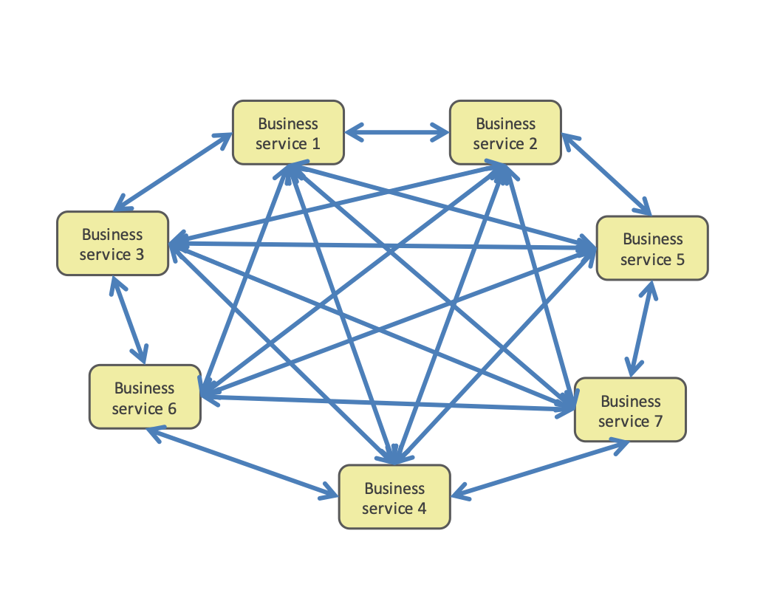
Cons of MSA (1/3) https://developer.ibm.com/technologies/microservices/articles/challenges-and-benefits-of-the-microservice-architectural-style-part-1/
Relational DB’s may be difficult to scale and complex to manage.
ACID transactions increase overhead.
There are many more moving parts that can break requiring more error handling and resiliency built into the system.

Slide 11
Cons of MSA (2/3) https://developer.ibm.com/technologies/microservices/articles/challenges-and-benefits-of-the-microservice-architectural-style-part-1/
Different technologies used for each service can lead to difficulties.
Team members who transition from one team/technology to another need to learn the new technology.
A diverse technology group requires more personnel for maintenance.
Dependencies between many services can lead to a “microservices death star”. Adjustments to one service may require adjustments to many.

Slide 12
Cons of MSA (3/3) https://developer.ibm.com/technologies/microservices/articles/challenges-and-benefits-of-the-microservice-architectural-style-part-1/
A complex and changing communication system between services is difficult to understand.
IP addresses and ports can get out of sync when updating.
It’s harder to implement integration testing when each team only deals with their own microservice.

Slide 13
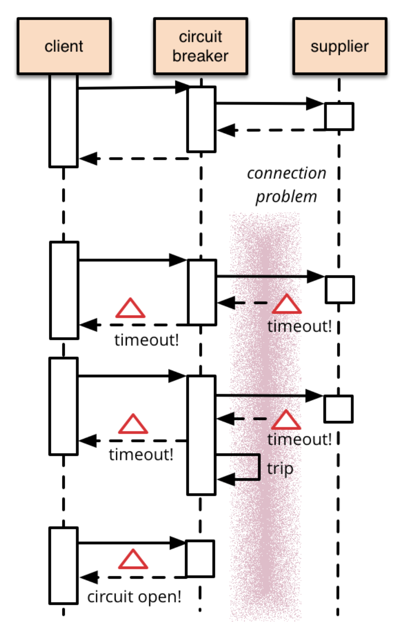
Circuit-Breaker Pattern https://martinfowler.com/bliki/CircuitBreaker.html
Remote calls can fail or hang without a response until their timeout limit is reached. If there are many callers on an unresponsive supplier, then you can run out of critical resources leading to cascading failures across multiple systems.
The Circuit-Breaker Pattern was developed by Michael Nygard to prevent these cascading failures.
To implement a “Circuit-Breaker”,
wrap a function call in a “circuit breaker” object which monitors for failures.
Once the failures reach a predetermined threshold, the circuit breaker trips, and
all further calls to the circuit breaker return with an error without the protected call being made again.

Slide 14
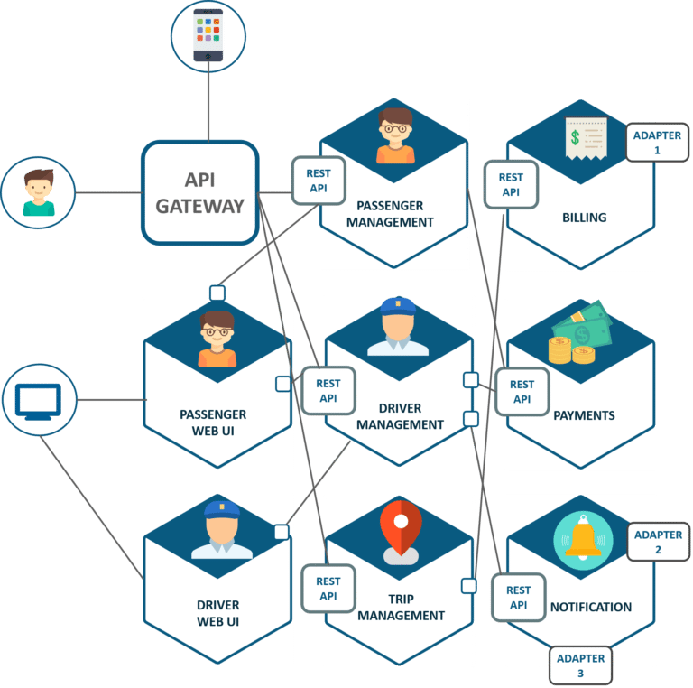
MSA Example and Requirements https://martinfowler.com/bliki/MicroservicePrerequisites.html
Certain capabilities must be in place before starting an MSA application.
Quick server creation – provisioning must be automated to respond to outages or fluctuating demand.
Accurate Monitoring – detect problems and quickly respond appropriately.
Fast deployment – Use a fully automated deployment pipeline to rapidly respond to developing needs.
Product-centered teams develop and maintain the same product for the lifetime of the product.

Slide 15
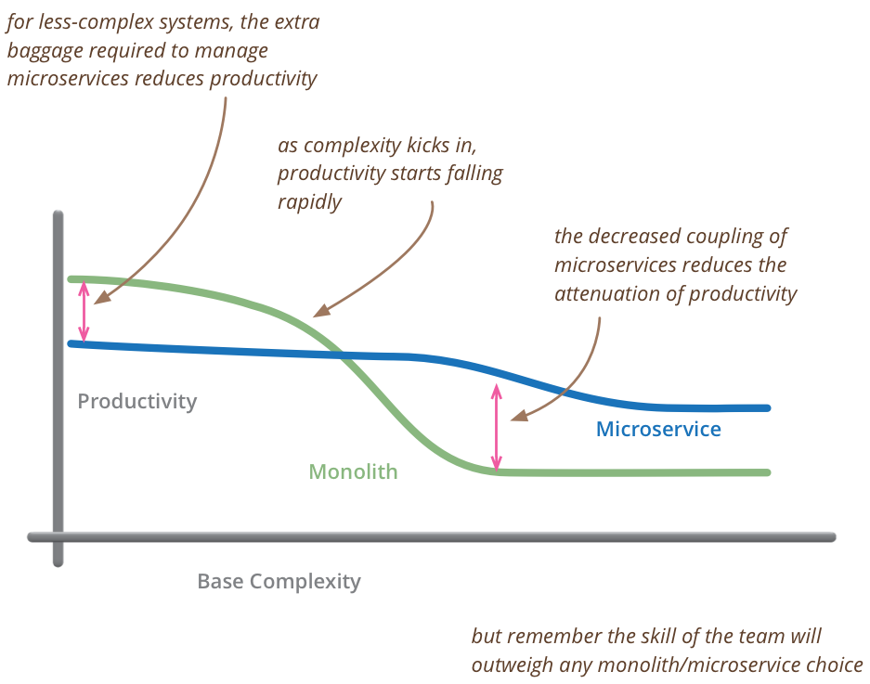
When is MSA Appropriate? https://martinfowler.com/bliki/MicroservicePremium.html
The decision to use microservices depends on the complexity of the planned system.
The MSA approach introduces its own set of complexities, such as:
automated deployment and monitoring.
dealing with failure.
gaining eventual consistency.
Don't consider microservices unless you have a system that's too complex to manage as a monolith.

Slide 16
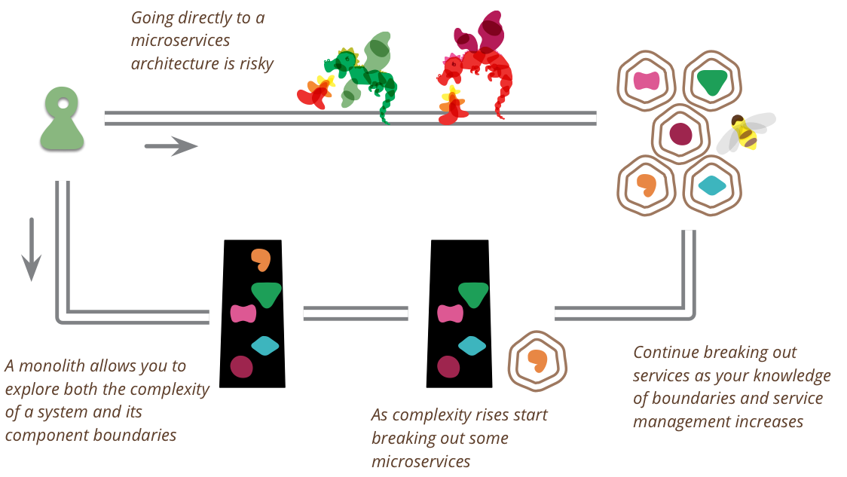
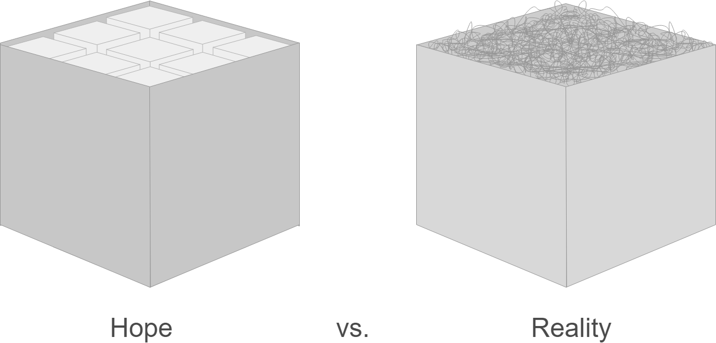
Migration from Monolith to MSA? https://martinfowler.com/articles/break-monolith-into-microservices.html
Developers must decide what type of structure is appropriate for their application.
Should you start with a monolith and evolve it to MSA if needed?
Pros:
It’s what most MSA ‘success stories’ have done.
Do we really know where to draw all the service boundaries before we have a Minimum Viable Product (MVP)?
Cons:
The monolith’s parts will inevitably be tightly coupled and difficult to decouple.
Good module separation in a monolith might not be the same as good service boundaries.

Slide 17
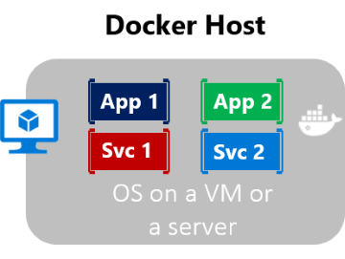
MSA and Containerization https://docs.microsoft.com/en-us/dotnet/architecture/microservices/container-docker-introduction/
An application, its dependencies, and its configuration are packaged together as a container image (containerized) and tested as a unit. Then deployed as a container instance to the host operating system.
Software containers act as standard units of software deployment. They contain different code and dependencies.
Each container can run a whole web application or just a single service.
Containers offer the benefits of isolation, portability, agility, reliability, scalability, and control.
Docker host is a container host, and App1, App2, Svc 1, and Svc 2 are containerized applications or services.

Slide 18
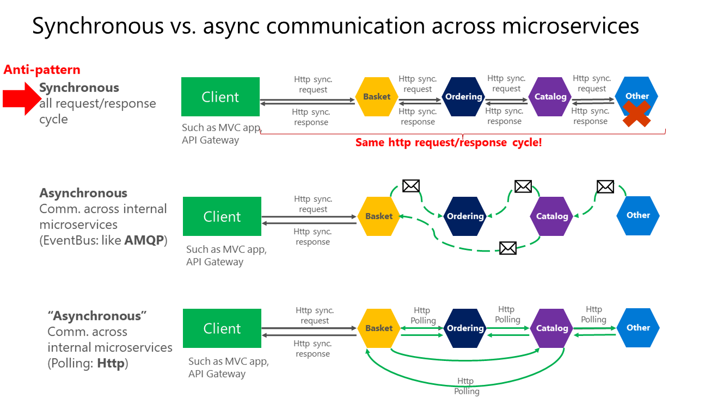

Slide 19
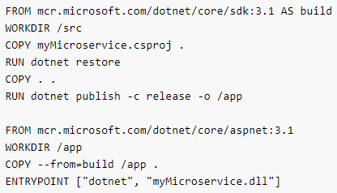
Microservices Tutorial (1/3) https://dotnet.microsoft.com/learn/aspnet/microservice-tutorial/intro https://dotnet.microsoft.com/learn/aspnet/microservice-tutorial/create
Create a new api with dotnet new webapi -o myMicroservice --no-https. This creates the template WeatherForecast API.
cd myMicroservice into the new directory.
Run it with dotnet run.
Make sure you have Docker with docker –version or download Docker here.
Create a Dockerfile with vim dockerfile (No suffix).
Add the text to the right to the Dockerfile.
Build the Docker Image with ‘docker build -t mymicroservice .’. The image is tagged as ‘mymicroservice’.
Check that the image is created with docker image ls.
Run the service in the container with ‘docker run -it -p 3000:80 --name mymicroservicecontainer mymicroservice’.
Verify that the container is running with docker ps.
Access the running app at http://localhost:3000/WeatherForecast.
Dockerfile text

Slide 20
Microservices Tutorial (2/3) https://dotnet.microsoft.com/learn/aspnet/microservice-tutorial/intro https://dotnet.microsoft.com/learn/aspnet/microservice-tutorial/create
Make sure you are signed into DockerHub with docker login in your command line.
Upload the docker image with
docker tag mymicroservice [YOUR DOCKER USERNAME]/mymicroservice
docker push [YOUR DOCKER USERNAME]/mymicroservice
Install Azure CLI and sign in with az login in command line.
Install Azure Kubernetes Service with az aks install-cli. (ignore PATH variable config. options)
Create a resource group with:
az group create --name MyMicroserviceResources --location westus
Create an AKS cluster in the resource group with:
az aks create --resource-group MyMicroserviceResources --name MyMicroserviceCluster --node-count 1 --enable-addons http_application_routing --generate-ssh-keys
Download the credentials for the AKS Cluster with:
az aks get-credentials --resource-group MyMicroserviceResources --name MyMicroserviceCluster
cd back into the directory you created the service ‘MyMicroservice’.
Create a deployment .yml file to hold the instructions for deployment with touch deploy.yaml.

Slide 21
Microservices Tutorial (3/3) https://dotnet.microsoft.com/learn/aspnet/microservice-tutorial/intro https://dotnet.microsoft.com/learn/aspnet/microservice-tutorial/create
---
apiVersion: apps/v1
kind: Deployment
metadata:
name: mymicroservice
spec:
replicas: 1
template:
metadata:
labels:
app: mymicroservice
spec:
containers:
- name: mymicroservice
image: [YOUR DOCKER USERNAME]/mymicroservice:latest
ports:
- containerPort: 80
env:
- name: ASPNETCORE_URLS
value: http://*:80
selector:
matchLabels:
app: mymicroservice
---
apiVersion: v1
kind: Service
metadata:
name: mymicroservice
spec:
type: LoadBalancer
ports:
- port: 80
selector:
app: mymicroservice
deploy.yaml
Copy the text to the right into deploy.yml.
Run the deployment with:
kubectl apply –f deploy.yaml
See the details of the deployed service with:
kubectl get service mymicroservice --watch
Look for the External IP address and see the deployed site with:
http://[EXTERNAL IP]/WeatherForecast
To scale up your services to 2 (or more), use:
kubectl scale --replicas=2 deployment/mymicroservice
Delete all created resources with:
az group delete –n MyMicroservice Resources
Replace [YOUR DOCKER USERNAME] with your actual Docker ID.

